Slide 1
Priority Queue
Parinya Sanguansat

Slide 2

Queue
Priority first
3
2
4
1

Slide 3

Priority Queue Interface
public interface PriorityQueue : Queue
{
//new object dequeue();
//new object peek();
}

Slide 4
Priority Queue Services
Enqueue: put an element at the last in queue
Dequeue: remove an element with highest priority
Peek: tell what is an element with highest priority
queue.enqueue(1);
object x1 = queue.peek();
queue.enqueue(2);
object x2 = queue.peek();
queue.enqueue(1);
object x3 = queue.peek();
queue.enqueue(3);
object x4 = queue.peek();
queue.dequeue();
object x5 = queue.peek();
queue.enqueue(4);
object x6 = queue.peek();
3
1
2
1
4

Slide 5

How to find the highest priority?
Define the priority which is comparable by using C# IComparable interface
Compare with IComparable.CompareTo method
2 > 1?
B > A?
Red > Green?
Somchai > Sombat?
int a.CompareTo(object b)
if a>b return positive
if a=b return zero
if a<b return negative

Slide 6
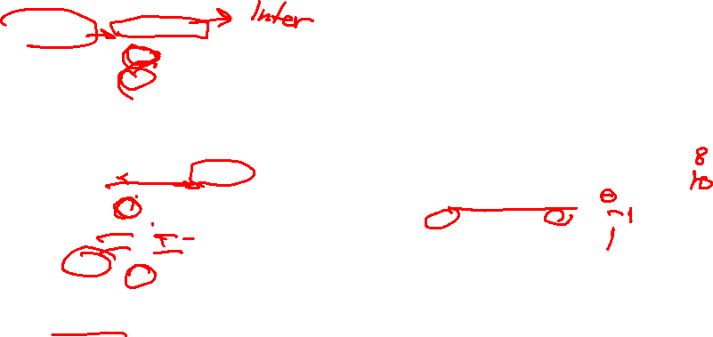
Example: IComparable
Compare rectangle by its area
class Rectangle : IComparable
{
private double W;
private double H;
public Rectangle(double W, double H)
{
this.W = W;
this.H = H;
}
public int CompareTo(object e)
{
Rectangle E = (Rectangle)e;
double Area1 = W*H;
double Area2 = E.W*E.H;
if (Area1 > Area2)
return 1;
if (Area1 < Area2)
return -1;
return 0;
}
}
Rectangle x = new Rectangle(2, 4);
Rectangle y = new Rectangle(5, 2);
int z1 = x.CompareTo(x);
int z2 = x.CompareTo(y);
int z3 = y.CompareTo(x);

Slide 7
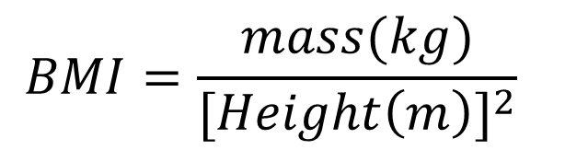
Class work 1: IComparable
ให้นักศึกษาเขียนคลาส Human มีสามารถเปรียบเทียบได้ โดยให้เปรียบเทียบความอ้วนด้วยค่าดัชนีมวลกาย (BMI)
$$BMI=\frac{mass(kg)}{{[Height\left(m\right)]}^{2}}$$

Slide 8

Implement with ArrayList
ArrayListPriorityQueue
public class ArrayListPriorityQueue : PriorityQueue
{
private List list;
public ArrayListPriorityQueue(int cap)
{ list = new ArrayList(cap); }
public bool isEmpty() { return list.isEmpty(); }
public int size() { return list.size(); }
public void enqueue(object e) { list.add(e); }
public object dequeue() {}
public object peek() {}
private int HighestPriorityIndex() {}
}

Slide 9

ArrayListPriorityQueue: peek
private int HighestPriorityIndex()
public object peek()
private int HighestPriorityIndex()
{
if (isEmpty())
throw new System.MissingMemberException();
int i = 0;
for (int j = 1; j < list.size(); j++)
{
IComparable c = (IComparable)list.get(j);
if (c.CompareTo(list.get(i)) > 0)
i = j;
}
return i;
}
public object peek()
{
return list.get(HighestPriorityIndex());
}

Slide 10
ArrayListPriorityQueue: dequeue
public object dequeue()
public object dequeue()
{
int i = HighestPriorityIndex();
object e = list.get(i);
list.remove(i);
return e;
}

Slide 11
Class work 2: LinkedListPriorityQueue
Create class LinkedListPriorityQueue
Implement Priority Queue with Linked List

Slide 12









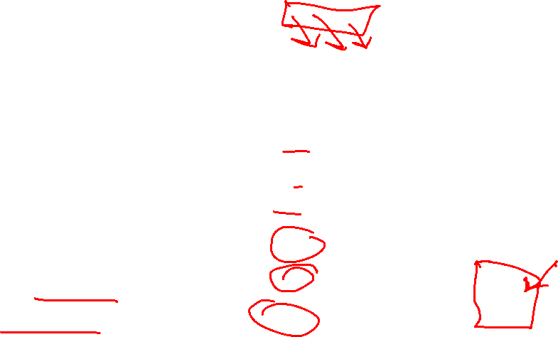



Complexity
constructor
isEmpty
size
enqueue
dequeue
peek
ArrayListPriorityQueue
LinkedListPriorityQueue
$$Θ(c)$$
$$Θ(1)$$
$$Θ(1)$$
$$Θ(1)$$
$$Θ(1)$$
$$Θ(1)$$
$$O(n)$$
$$Θ(1)$$
$$Θ(n)$$
$$Θ(n)$$
$$Θ(n)$$
$$Θ(n)$$

